Slide 1
Addressing Financial Literacy Using Cashcourse
Chinh Pham
Stacey Smith
Paolo Varquez
Notes:
Stacey

Slide 2
Agenda
Financial literacy stats
CashCourse
Faculty resources
Practical implementation ideas
Q&A
Notes:
Stacey

Slide 3
Why? Stats on Financial Literacy
60% of US adults have credit card debt the past 12 months (National Foundation for Credit Counseling, 2019)
44% of Americans don’t have cash enough to cover a $400 emergency (Forbes, 2018)
33% of American adults have $0 saved for retirement (Forbes, 2018)
Americans owe $1.2 trillion in auto loan debt and the average new car payment is $550 a month (LendingTree, 2020)
Americans owe over $1.64 trillion in student loan debt with the average debt of $29,900 (Student Loan Hero, 2020)
Notes:
Paolo
Connect to guided pathways

Slide 4
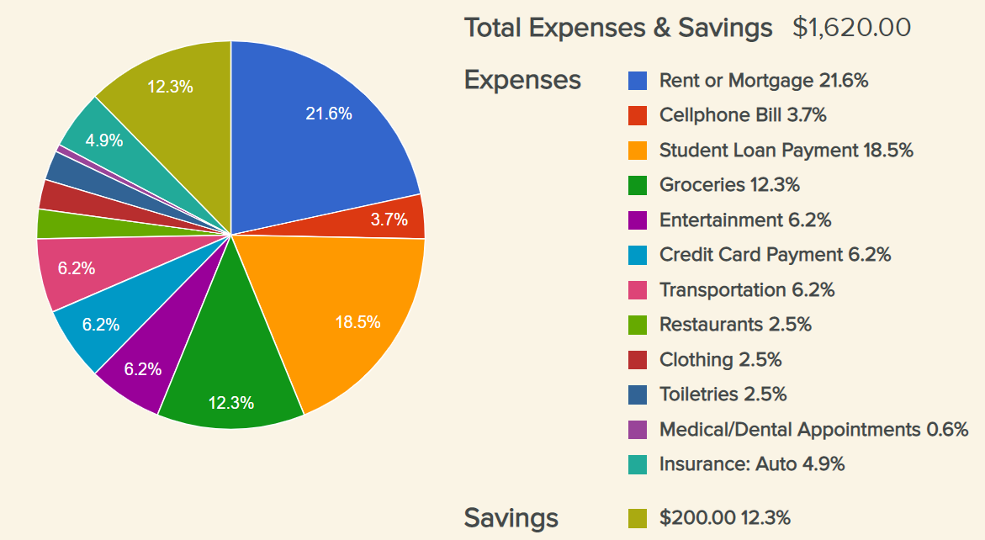
What is CashCourse?
CashCourse is a free online financial education resource designed specifically for college students. The program takes a whole-life approach to personal finance, with resources divided into six main areas of learning:
Earn
Save and invest
Protect
Spend
Borrow
Pay for Education
Notes:
Chinh
Version 1.0

Slide 5
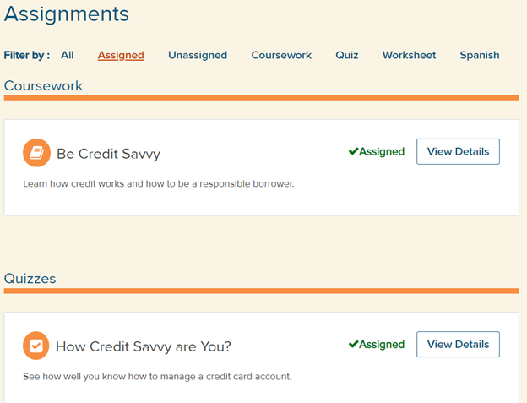
Faculty Resoures
Workshop kits that include ready-made PowerPoint presentations and facilitator’s guides
Campus Planning Workbook to guide you through creating your program or assignment
The ability to make assignments for students and track their progress

Slide 6
Practical Implementation Ideas
Assign mini-courses, worksheets, and quizzes for points or extra credit.
Since financial literacy is relevant to ALL students, material can be complementary to courses in any discipline.
Award points for completion of assignments. Although CashCourse is not integrated with Canvas, students can submit proof of completion which makes grading through SpeedGrader easy.
“I think everyone… should be taught about credit before going to the real world. (CashCourse) is great for the students because it is short, straight to the point, and tests basic knowledge and understanding without losing the students’ attention.”
–G. Ruiz, Coastline Economics Student
Notes:
20-30% improvement in pre and post-test scores

Slide 7
Fill out Google Form
Notes:
Paolo

Slide 8
Contact Info
Chinh Pham
cpham15@coastline.edu
Stacey Smith
ssmith301@coastline.edu
Paolo Varquez
pvarquez1@coastline.edu
Notes:
Chinh

